Slide 1
Lectuer-3 Database Design and Applications
Ashish Narang

Slide 2
First Semester
2020-21

Slide 3
Contents
Relational Model
Characteristics
Relational constraints
Representation of Schemas
ER to Relational Mapping

Slide 4
Relational Model
Edgar Codd proposed Relational Data Model in 1970.
It is a representational or implementation data model.
Using this representational (or implementation) model we represent a database as collection of relations.
The notion of relation here is different from the notion of relationship used in ER modeling.
Relation is the main construct for representing data in relational model.
Every relation consists of a relation schema and relation instance

Slide 5
Relational Schema and Relation Instance
Each Relation Schema is represented by relation name and attribute list.
R= (A₁, A₂,A₃,…….A_{n})
Relation instance of relation schema R (A₁, A₂, A₃,…….A_{n}) is denoted by r(R) is a set of n records.
r={t₁,t₂, t₃,….t_{n}}

Slide 6
Relational Model Concepts
Relational model represents the database as collection of relations.
In a formal relational model terminology,
A row is called a tuple.
Column header is called an attribute
A table is called a relation
A data type describing the type of values that can appear in column is represented by domain of possible values.

Slide 7
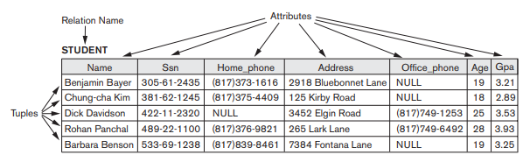
Example of a Relation

Slide 8
Characteristics of a Relation
Ordering of tuples
-Tuples in relation do not follow any order
Values and null values in tuple
-Each value in a tuple is atomic value
-Null values are used to represent the value that is unknown or not applicable.
Interpretation of a relation

Slide 9
Relational Model Constraints
In a relation database, there will be typically many relations and tuples in these relations are related in various ways. We can divide the constraints as
Schema based constraints
Application based constraints

Slide 10
Domain Constraint
Domain constraint specify that with in each tuple, the value of each attribute must be an atomic value from that domain.
The data type associated with each domain include integers, real numbers, characters, boolean, fixed length strings, date and time etc.

Slide 11
Key Constraints
A relation is defined as set of tuples.
Key constraint specifies that all tuples in relation must be distinct.
Each tuple must have unique combination of values.
It introduces the concept of
-Candidate key
-Primary key
-Super key

Slide 12
Relational Database Schema
A relation schema is a set of relations and a set of integrity constraints.
When we refer to a database, we implicitly include both its schema and current state.
A database state which does not obey all the integrity constraints is called an invalid state.
A database state which satisfies all the constraints is a valid state.

Slide 13
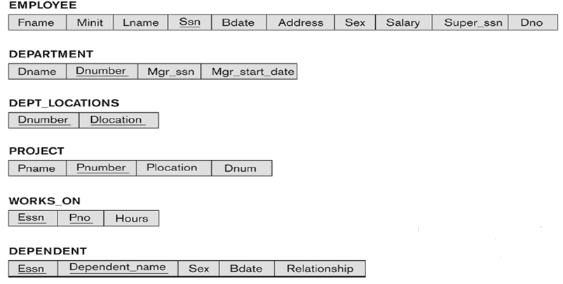
Contd..
Schema of a Company Database

Slide 14
Entity Integrity Constraint
Entity integrity constraint specifies that no primary key value can be null.
Primary key value is used to identify individual tuples in a relation.
Having null values for primary key implies we can not identify individual tuples in a relation.

Slide 15
Referential Integrity Constraint
Referential integrity constraint specifies that tuple in one relation must refer to existing tuples in the other relation.
Referential integrity constraint maintains consistency in the database.

Slide 16
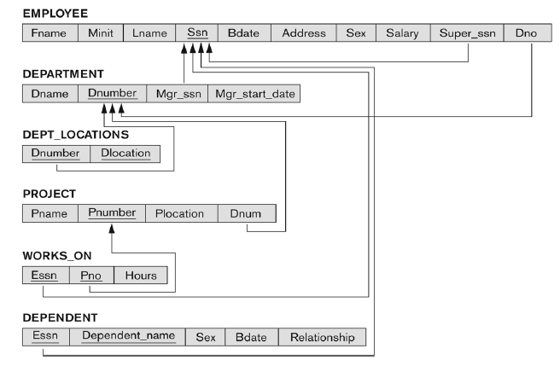
Contd..
Referential Integrity Constraints on a Company Database

Slide 17
Other Types of Constraints
Salary of employee should not exceed the salary of Employees supervisor.
Maximum number of hours an employee can work on a project per week is 56 hours.
Salary of employee should increase only.
These constraints can be enforced through application programs.

Slide 18
Data Manipulation and Dealing With Constraint Violation
The two basic operations that are performed on a database are
-Retrieve
-Update
Retrieving means simply querying a database for some information.
Update operation consist of three operations.
-Insert
-Delete
-Modification

Slide 19
Insert operation
Insertion means adding new rows to the table.
Insert operation can violate four types of constraints.
-Domain constraint
-Key constraint
-Entity integrity
-Referential integrity

Slide 20
Delete Operation
Delete operation deletes tuples from relation.
Delete operation can violate
-Referential integrity
If tuple being deleted is referenced by foreign keys from other tables in the database.

Slide 21
Update Operation
Update operation change the value of one or more attributes in a tuple.
If attribute not part of a primary key nor of a foreign key
Usually causes no problems
Updating a primary/foreign key
Similar possible constraint violations as with Insert/Delete

Slide 22
ER to Relational Mapping
Mapping Regular Entity Types
Mapping Weak Entity Types
Mapping 1:1 Relationships
Mapping 1:N Relationships
Mapping N:M Relationships
Mapping Multi-valued Attributes
Mapping n-ary relationships
Mapping Class Hierarchies

Slide 23
Mapping Entity Types
Mapping of Regular Entity Types.
For each regular (strong) entity type E in the ER schema, create a relation R that includes all the simple attributes of E.
Choose one of the key attributes of E as the primary key for R.
If the chosen key of E is composite, the set of simple attributes that form it will together form the primary key of R.

Slide 24
Mapping of Weak Entity Types
For each weak entity type W in the ER schema with owner entity type E, create a relation R & include all simple attributes (or simple components of composite attributes) of W as attributes of R.
Also, include as foreign key attributes of R the primary key attribute(s) of the relation(s) that correspond to the owner entity type(s).
The primary key of R is the combination of the primary key(s) of the owner(s) and the partial key of the weak entity type W, if any.

Slide 25
Mapping Relationship Types
Mapping of Binary 1:1 Relation Types
For each binary 1:1 relationship type R in the ER schema, identify the relations S and T that correspond to the entity types participating in R. There are three possible approaches:
1. Foreign Key approach: Choose one of the relations-say S-and include a Mapping Relationship types foreign key in S that refers to the primary key of T. It is better to choose an entity type with total participation in R in the role of S.
2. Merged relation option: An alternate mapping of a 1:1 relationship type is possible by merging the two entity types and the relationship into a single relation. This may be appropriate when both participations are total.
3. Cross-reference or relationship relation option: The third alternative is to set up a third relation R for the purpose of cross-referencing the primary keys of the two relations S and T representing the entity types.

Slide 26
Mapping of Binary 1:N Relationship Types
For each regular binary 1:N relationship type R, identify the relation S that corresponds to the entity type with total participation at the side of the relationship type.
Include as foreign key in S the primary key of the relation T that represents the other entity type participating in R.
Include any simple attributes of the 1:N relation type as attributes of S.

Slide 27
Mapping of Binary M:N Relationship Types.
For each regular binary M:N relationship type R, create a new relation S to represent R.
Include as foreign key attributes in S the primary keys of the relations that represent the participating entity types; their combination will form the primary key of S.
Also include any simple attributes of the M:N relationship type (or simple components of composite attributes) as attributes of S.

Slide 28
Mapping of Multi-valued Attributes
For each multivalued attribute A, create a new relation R.
This relation R will include an attribute corresponding to A, plus the primary key attribute K-as a foreign key in R-of the relation that represents the entity type of relationship type that has A as an attribute.
The primary key of R is the combination of A and K. If the multivalued attribute is composite, we include its simple components.

Slide 29
Mapping of N-ary Relationship Types
For each n-ary relationship type R, where n>2, create a new relationship S to represent R.
Include as foreign key attributes in S the primary keys of the relations that represent the participating entity types.
Also include any simple attributes of the n-ary relationship type Mapping n-ary relationships (or simple components of composite attributes) as attributes of S.
Example: The relationship type SUPPLY in the ER on the next slide.
This can be mapped to the relation SUPPLY shown in the relational schema, whose primary key is the combination of the three foreign keys {SNAME, PARTNO, PROJNAME}

Slide 30
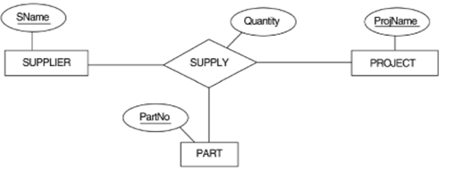
Contd..

Slide 31
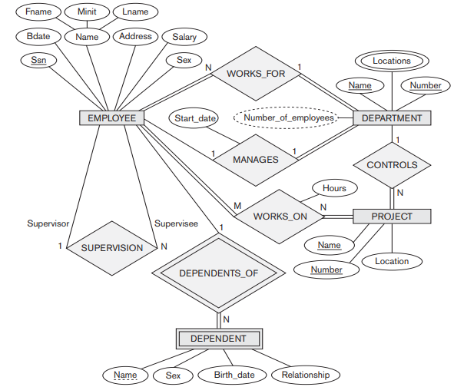
ER Diagram of Company Database

Slide 32
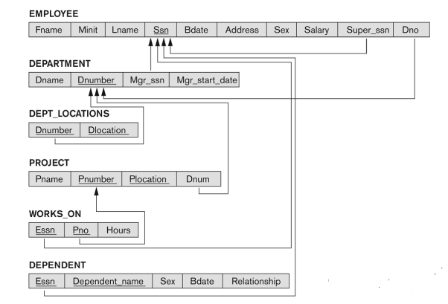
ER-Relational Mapping for Company Database

Slide 33
Mapping Class Hierarchies
Options for Mapping Specialization or Generalization.
• Option 8A: Multiple relations-Superclass and subclasses
• Option 8B: Multiple relations-Subclass relations only

Slide 34
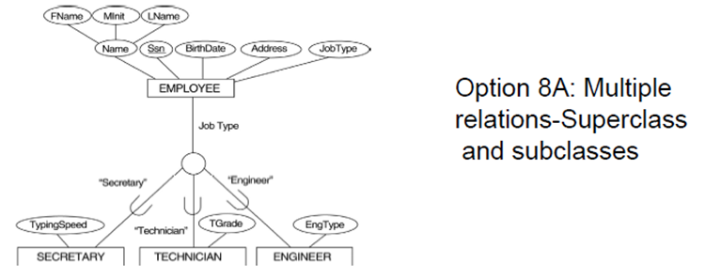
Contd..

Slide 35
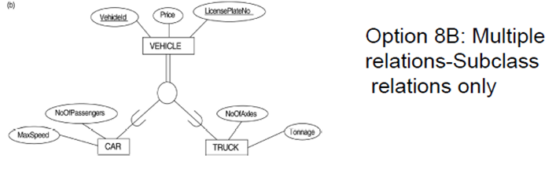
Contd..

